Slide 1
CS 1: Welcome and Introduction
CS 163 and CS 164: Java Programming
WARM UP QUESTION – Name, Why are you in this course, and something you are most nervous about?
Colorado State University
Computer Science Department
Slides Originally Created by Albert Lionelle (Albert.Lionelle@colostate.edu)

Slide 2
Weekly Announcements!
TODO Reminders:
Setup MS Teams
Reading 1 (Zybooks)
Syllabus Quiz
Knowledge Check
Will have these up every week!
Start of every class as you come to class.
Class FRIDAY
Reading 1 done before Friday
Lab Thursday is to help with that
Always, always plan for readings to be done before class.

Slide 3
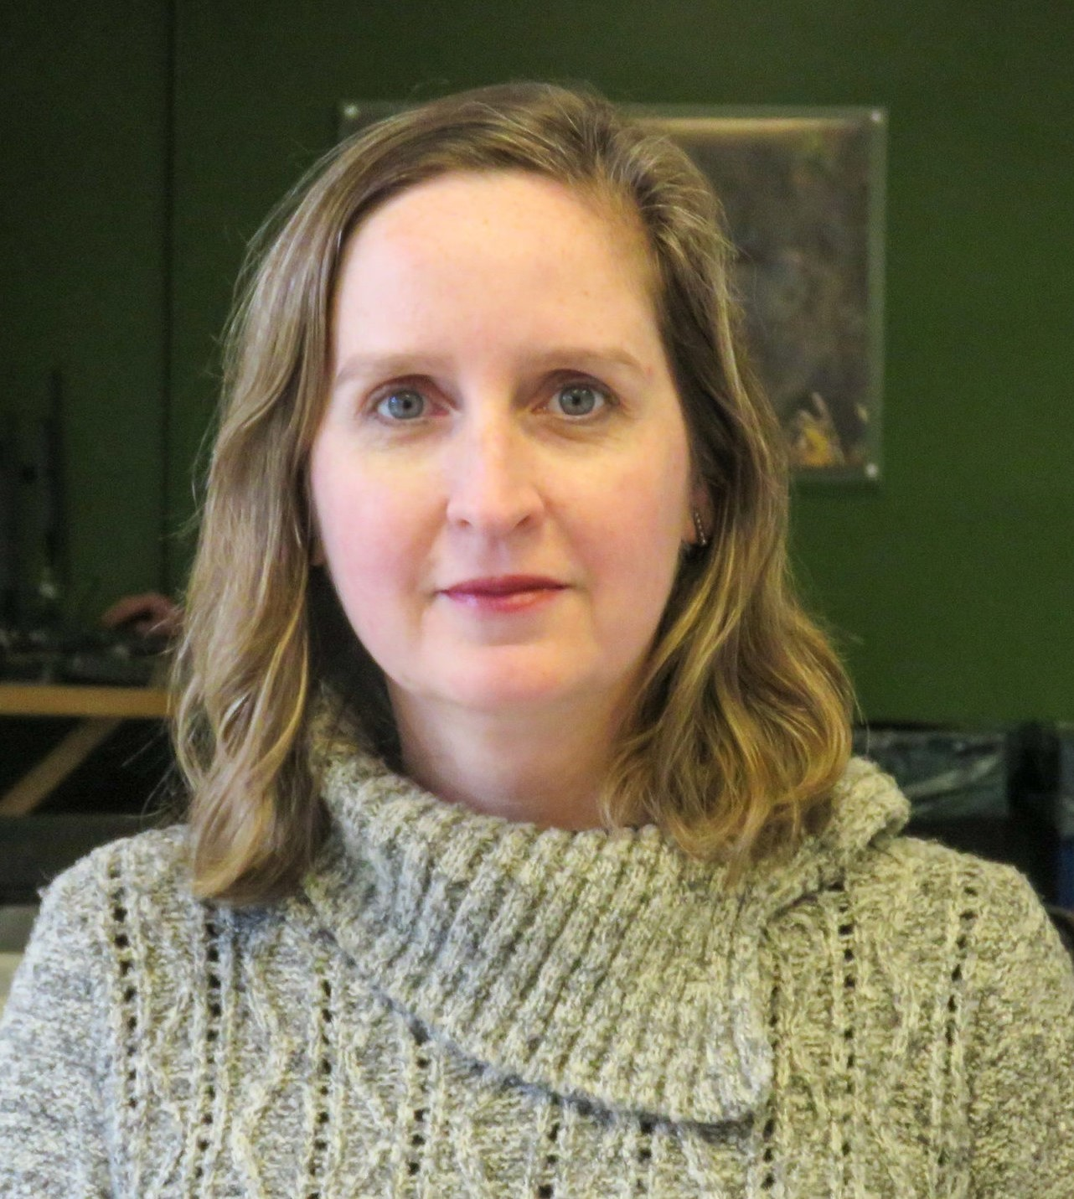

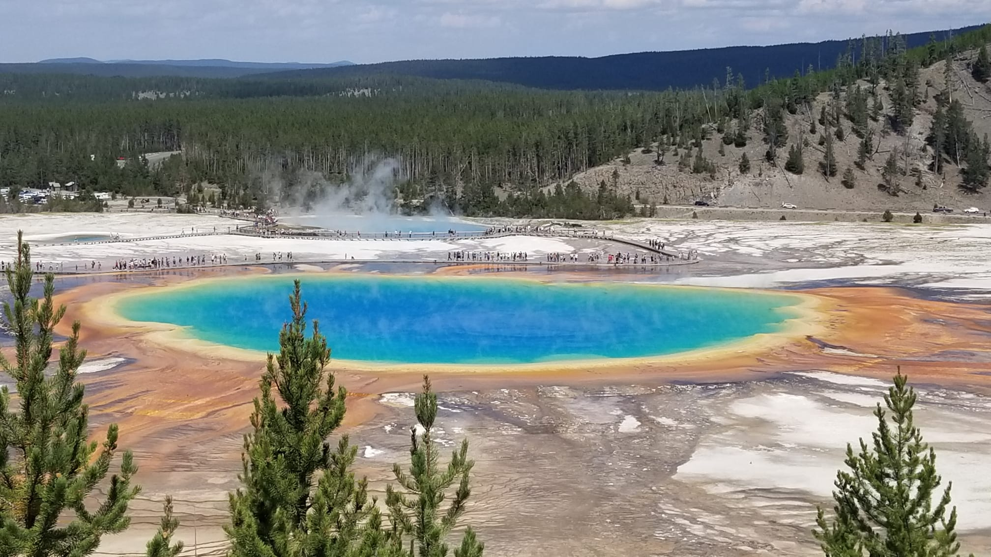
Who Am I?
PhD in Computer Science from Federal University of Rio Grande do Sul (UFRGS), Brazil
Artificial Intelligence applied to Education
PhD Student in Education Science working with Learning Analytics, School of Education, CSU
22 years of experience in Higher Education
16 years as Assistant Professor at the Computer Science Department, Pontifical Catholic University of Rio Grande do Sul (PUCRS), Brazil
6 years as a researcher at the Center for the Analytics of Learning and Teaching (C-ALT), CSU
Research Interests
Computer Science Education
Learning Analytics
Technology Enhanced Teaching and Learning
Outside Interests
Reading
Traveling with my family
Riding my bicycle

Slide 4
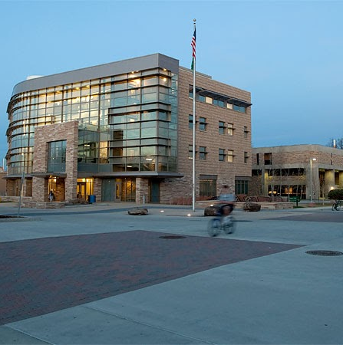
Instructor: How to Contact Me?
MS Teams Private Message
*BEST WAY*
email (poor), canvas (very bad!!)
General questions
Post in the general channel!
Let’s other see the answer
Check the Syllabus for Office Hours!
Mixed MS Teams and Office
stop by either but may need to wait.

Slide 5
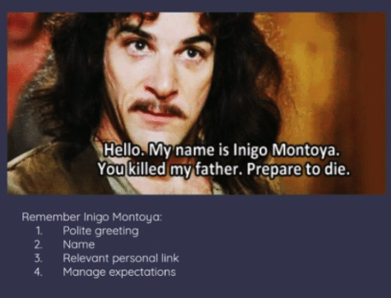
Remember!
Remind me which class! (I teach multiple)
Relative personal link == class you are in ☺
Manage Expectations
Short question

Slide 6
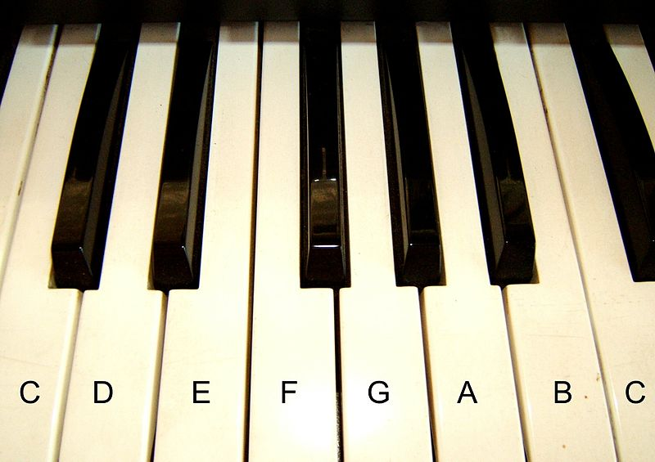


Topics Covered
Basic Java Programming
Variables
Control Structures (Branching)
Loops
Arrays
ArrayLists
Classes
Inheritance
Polymorphism
Essentially - learning the tool to build basic programs!
Problem Solving
Divide-Conquer-Glue
A way to look at the world
Like learning music - programming takes practice, practice, practice
Attribution: Algont
Computational Thinking:
Decomposition
Pattern Recognition
Abstraction
Algorithms

Slide 7
Teaching Approach/Concepts
Based on Psychology of Learning (4 week cycles)
Spacing
Interleaving
Practiced Recall
Elaboration
Reflection
Grading
Formative – Can be redone!
Summative – Demonstrate what you know
You are learning
A new language
A different way of thinking (Divide-Conquer-Glue)
OK to struggle!
To have another language is to possess a second soul. - Charlemagne (748 –814)

Slide 8
Course Structure - Follow Canvas
Readings
Due before Lectures - Sunday, Tuesday and Thursday nights
Lectures
Active learning, a lot of group discussion and coding – BE HERE – or you will miss out.
Labs
Meant to be done after lecture content, due day assigned - coding/writing code
Knowledge Checks
Required to move onto the next module
Your best study tools
Exams
Canvas exams – reading content
Coding exams – writing content
Practical
These are large and hard programming assignments (usually 2 weeks), that bring it all together

Slide 9
Knowledge Checks
Focus on Reading Code
Also help with recall
Best thing to do – go back to them
Interleave – pick different orders to redo them from time to time
Spacing – do some every night!
Psychology of learning – this helps!
Best way to study for exams?
Every night – knowledge checks, practice exam
Retesting + spacing
You can do them 100 times, get different results every time!
Highest result is the one kept
 | ReStudy | ReTesting
Massed
Spaced
Most
People
Ideal For
Recall

Slide 10
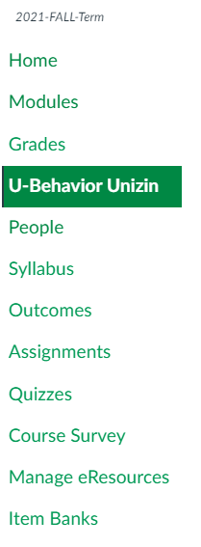
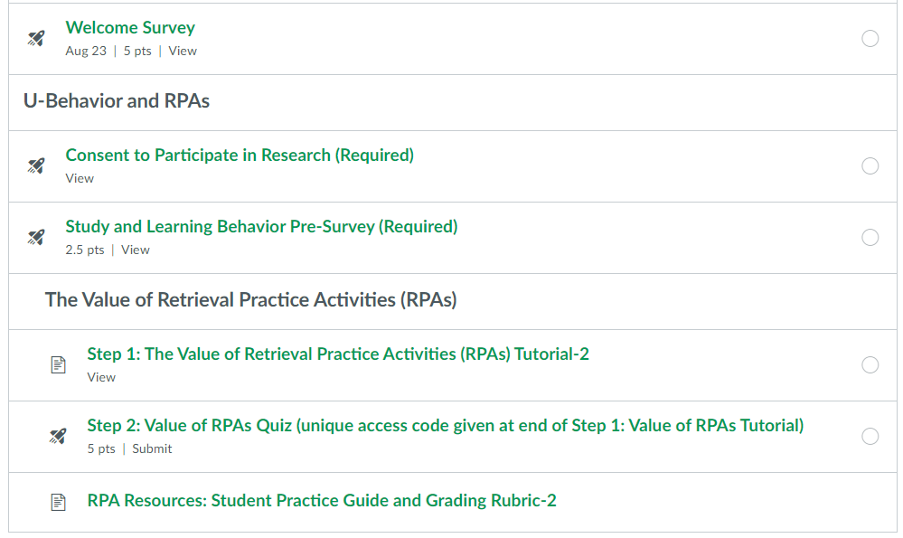
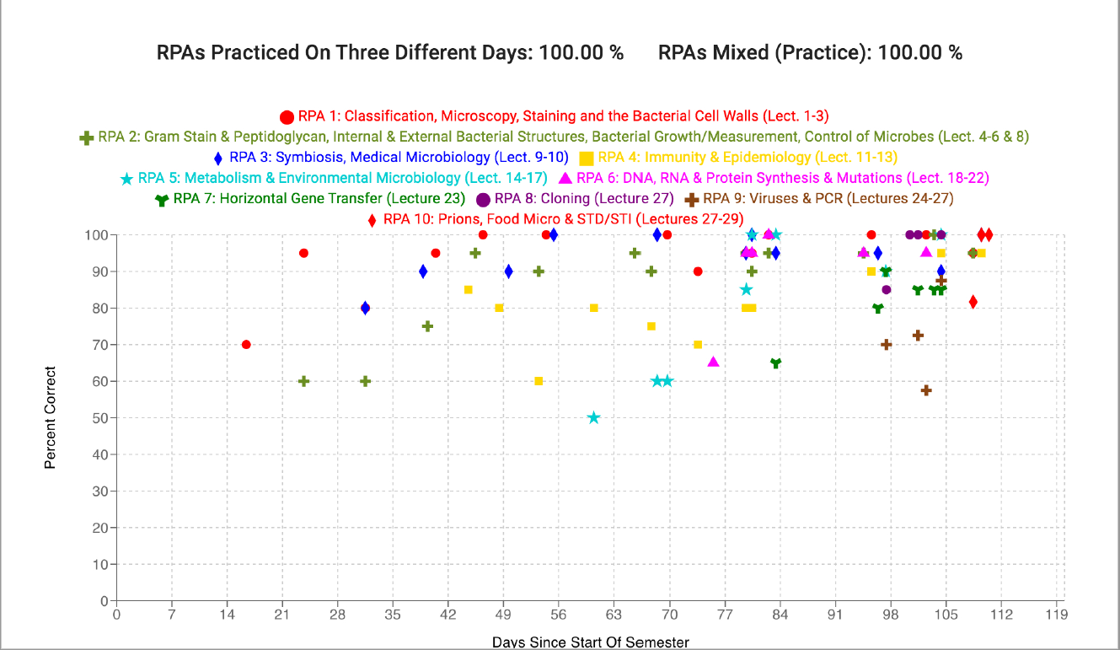
U-Behavior App and Research

Slide 11
Labs
Tuesday Labs
2 of 4 grade is based on activities / participation
Self-explanation in comments, drawing out graphs, writing tests
2 or 4 grade is based on submitted / auto graded (one is often just debugging)
All is meant to be done during lab.
Miss a lab, you need to coordinate with the lab TA.
Thursday Labs
Meant to building small programs
Can often take more than one day
Will have both provided code and your own code you write
4 of 4 is auto graded / based on working code.
Some of them *build* on each other, so you need past ones completed!

Slide 12
Help Sessions
Sign up for a help session!
Weekly meetings lead by TAs
Go over:
Course content
Assignments
Additional related material
Can’t make it
Online help session

Slide 13
MS Teams!
MS Teams
Used in industry
We make use for the course (mixed with online and on-campus students)
Install the Application! (not just the browser)
Use the General Channel (Study Group!)
General Questions
Knowledge Checks
Reading
aka, any question that doesn’t require posting code *you* write

Slide 14
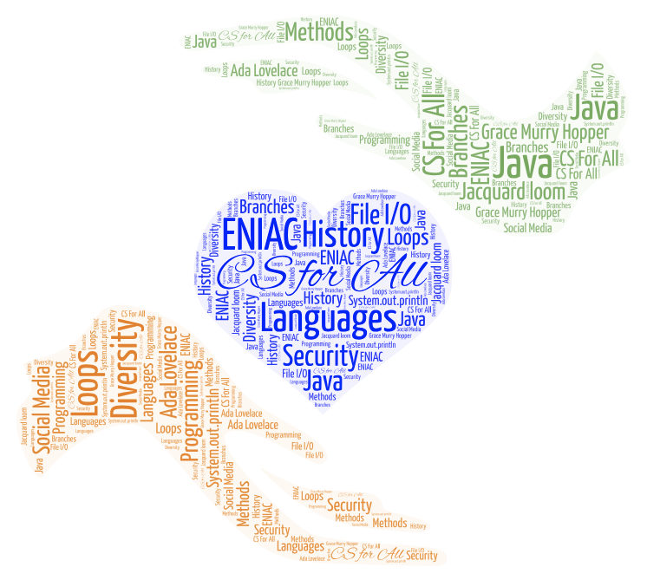
Most Importantly
Remember to Ask Questions
Stay Ahead / Don’t Fall Behind
Be kind to yourself - no one gets everything the first time.
Have fun!
Computer Science is using technology to solve problems!

Slide 15
And who was the first programmer?

Slide 16

The Right Honourable
Countess of Lovelace
Ada Lovelace (1815-1852)
English mathematician who worked with Charles Baggage on his Analytical Engine
In 1843 she translated an article written by the Italian mathematician and engineer Luigi Federico Menabrea, “Notions sur la machine analytique de Charles Babbage” and supplemented it with her own “Notes”
Her “Notes” contains what many consider to be the first computer program
Ability to connect the Arts and Science, she developed a vision of the capabilities of computers to go beyond calculation, it can do anything that can be noted in symbols, including words and music (https://www.britannica.com/biography/Ada-Lovelace/images-videos)
Ada Lovelace Day – second Tuesday in October
Photo By:
Alfred Edward Chalon [Public domain], via Wikimedia Commons

